Slide 1










Geek room
HACKATHONPROJECT
PRESENTED BY CODERS
Micosoft
Trae
.pathway

Slide 2





OUR TEAM
Mathiyazhagan T
Prathosh P
Arun pandiyan S
Vishnu Dharshan S

Slide 3

PROBLEM :
The world is generating information every second — from breaking news and team updates to sensor and market data. Traditional AI assistants, however, rely on static, outdated datasets that fail to reflect real-time changes. This creates a gap between what’s actually happening and what AI can respond with. As a result, teams face delays in knowledge sharing, while critical industries risk costly errors due to slow or outdated insights. Users often feel frustrated, misinformed, and left behind. The core problem is that AI is not keeping pace with the speed of human needs and real-time data.

Slide 4
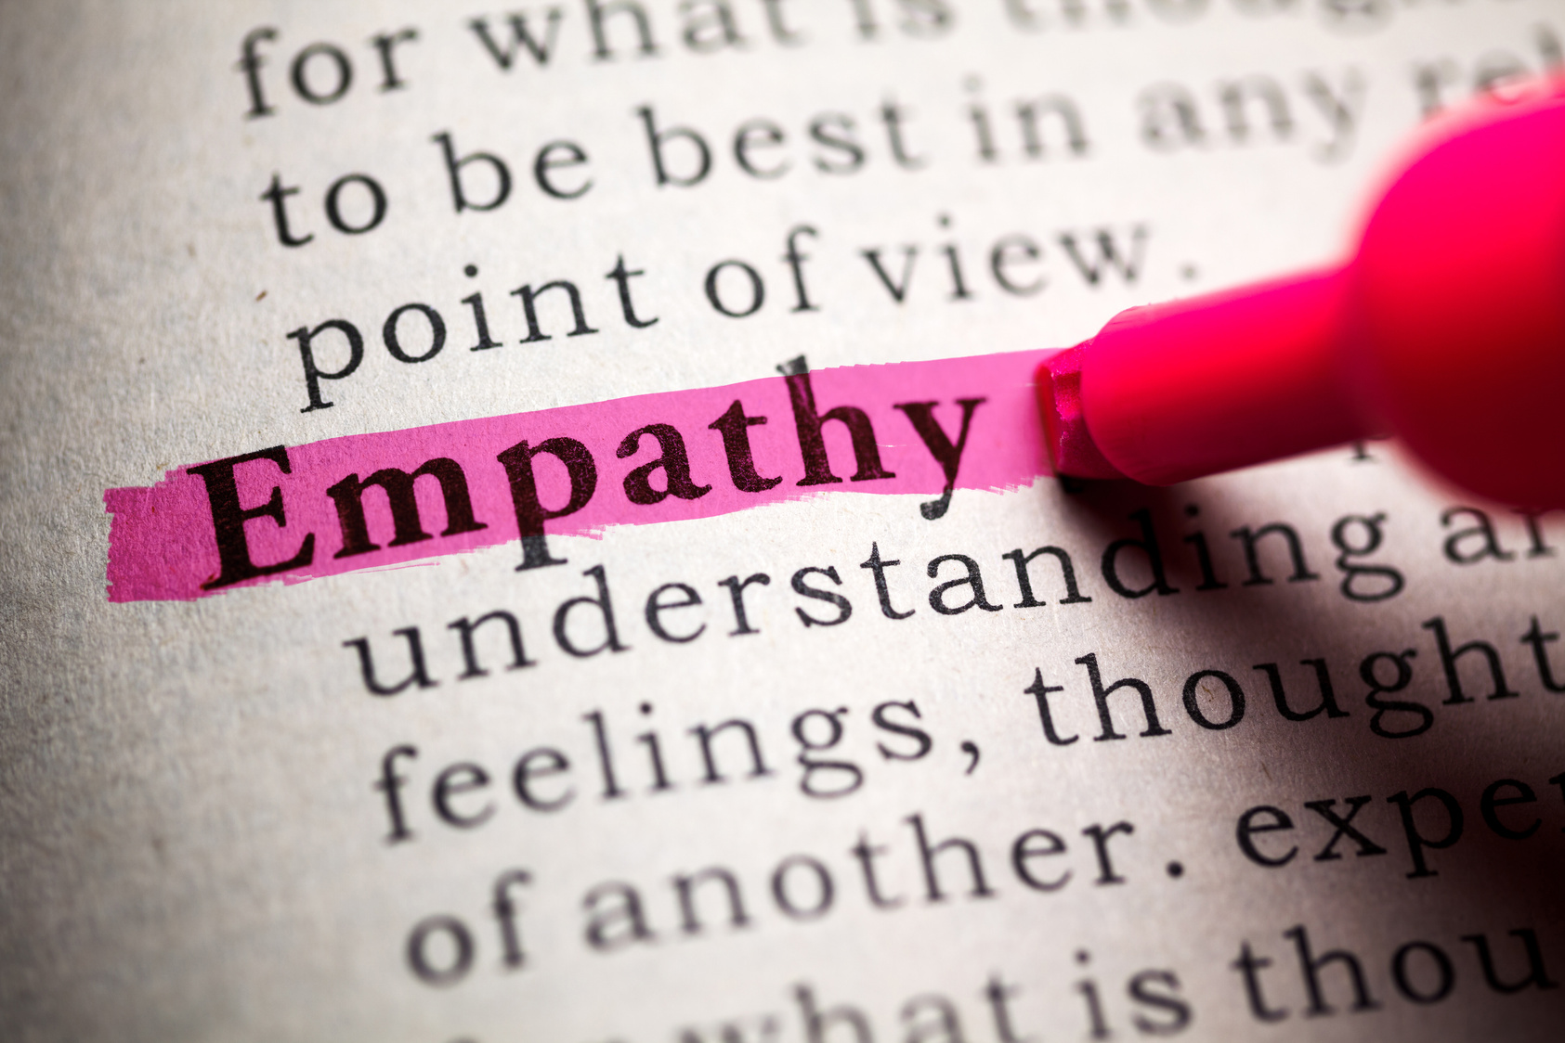
EMPATHY
Today, information changes every second — from breaking news and team updates to sensor readings and market data.
But most AI systems and dashboards rely on static datasets that don’t update in real time.
This creates a gap between reality and the AI’s knowledge, leading to delays, misinformation, and poor decision-making.
People drown in fast-changing information.
AI assistants rely on outdated, static data.
Knowledge sharing is delayed across teams.
In critical fields, even minutes of lag cause big risks.
Users feel frustrated, misinformed, and left behind.

Slide 5



DEFINE
Information is changing every second — news, team notes, or sensor updates.
Traditional AI assistants rely on static data and fail to adapt instantly.
Users face delays, misinformation, and frustration when AI responses don’t reflect the latest updates.
There’s a gap between what’s happening now and what AI knows.

Slide 6
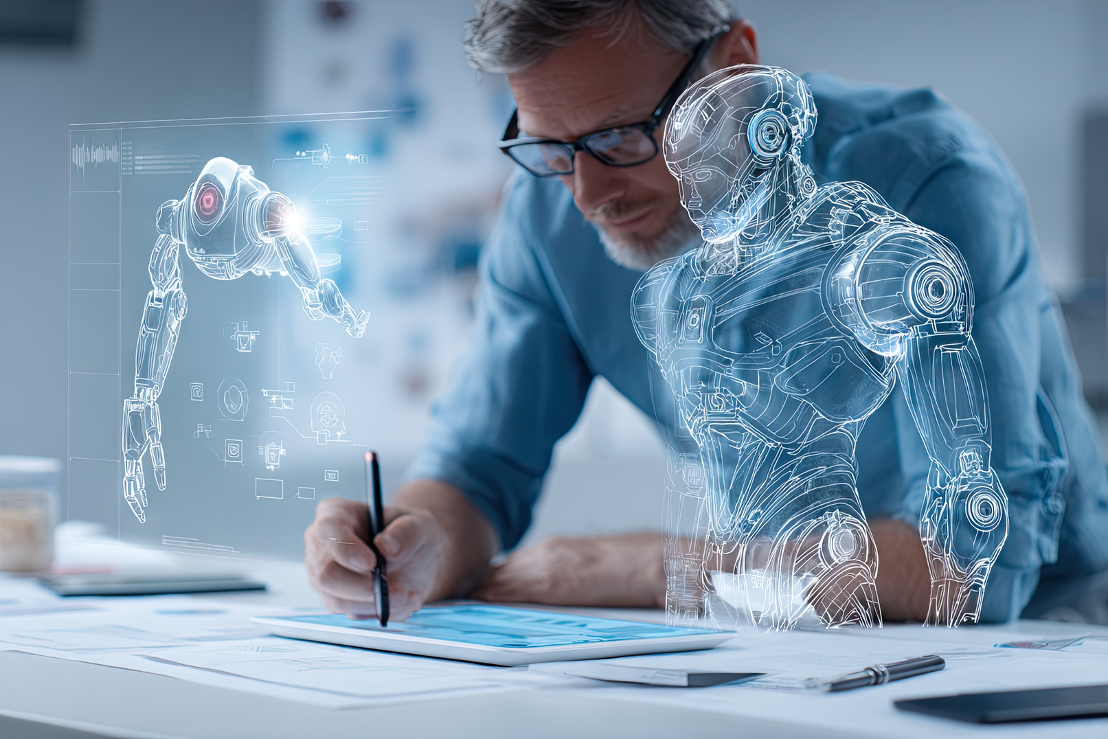
IDEATE
Our Solution Idea
Build a real-time AI bot that:
Fetches live news instantly from trusted sources.
Allows users to upload documents and query them dynamically.
Updates answers in real time as soon as new data (news or docs) arrives.
Powered by Pathway + RAG (Retrieval-Augmented Generation) to ensure continuous learning.
Provides trustworthy, context-aware answers without delays.

Slide 7
PROTOTYPE
Implementation Approach
Bot Framework: Built with Python + Streamlit for an interactive, simple UI.
AI Model: Integrated with Llama-2 7B for natural, intelligent responses.
Data Sources:
Live news API → for instant real-world updates.
Document upload → for personal/team knowledge queries.
Real-Time Processing: Pathway ensures the bot continuously ingests and updates knowledge, so answers change instantly.

Slide 8




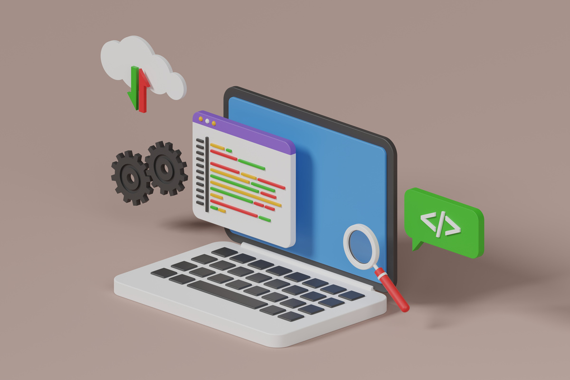
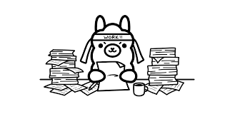
PROTOTYPE
Finall Result in streamlit
Using the streamlit for UI
using python programming
Fetch the data form ollama models

Slide 9
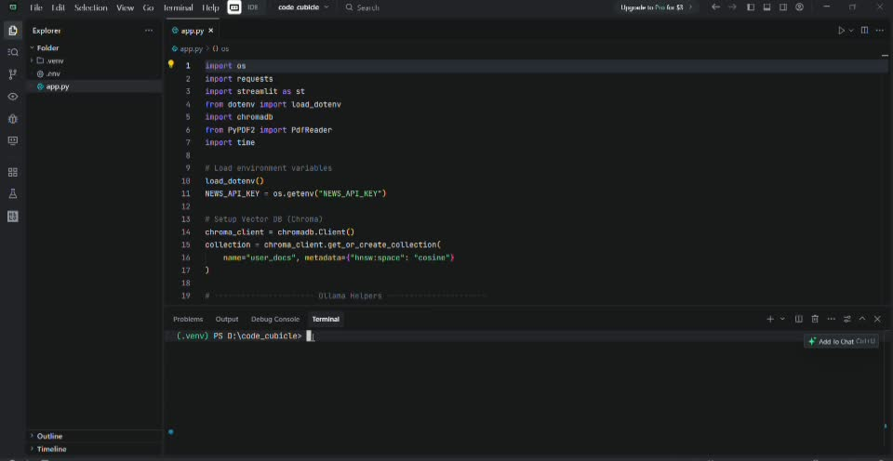
TESTING

Slide 10
TESTING

Slide 11
CONCLUSION
Our project addresses the gap between fast-changing real-world information and outdated AI systems. By building a real-time AI bot powered by Pathway, Streamlit, and Llama-2, we enable instant access to live news and dynamic document queries. This ensures that knowledge updates immediately as new data arrives, removing delays, misinformation, and frustration. The solution empowers users with trustworthy, real-time insights, leading to faster decisions, better collaboration, and stronger confidence in AI tools.

Slide 12
DOES ANYONE
have questions?

Slide 13
THANK
you

